Slide 1

RESEARCH
TOWN HALL
Sandra A. Brown
Vice Chancellor for Research
December 7, 2021

Slide 2
Welcome: VCR Sandra A. Brown
Funding Updates
Pandemic Update & Campus Status: Dr. Natasha Martin
Critical changes to NIH Applications: AVC Angela McMahill
ESR/HR Updates: Pierre Ouillet
Research Updates: SAVC Miroslav Krstic
Introducing incoming VCR Corinne Peek-Asa
Q&A

Slide 3
Strong Research Year for UC San Diego
~$1.6B in research support
(6% increase, 10% increase in federal funding)
19% increase in female PIs submitting proposals
(245/quarter)
22% increase in underrepresented minority PIs submitting proposals (255 quarter)
Major contribution to the national effort to understand and treat COVID
Challenges for UCSD/VA joint appointments is resolved
(Research activity using VA facilities, personnel, patients, etc.)
Notes:
VA/JPA:
Due to new Department of Justice interpretation of of 18 U.S.C. § 209, we had been told that new JPAs for joint appointees to conduct federally-funded research using VA resources would be prohibited.
We partnered with VASD to successfully make the case that UCSD qualifies for an exception to this code as a “treasury of the state.” This has been approved by the VA Office of General Counsel Ethics division.
Therefore, all JPAs for existing, new, and renewal applications submitted through VMRF to NIH, DoD, PCORI, and TRDRP can proceed without any violation of the US Code.
VA’s OGC Ethics Counsel will review any other sponsors (eg, private research foundations), but we will continue to make the case that these agreements are also subject to the “treasury of the state” exception.

Slide 4
Strong Research Year for UC San Diego
Challenges for UCSD/VA joint appointments is resolved for JPAs
(Federally-funded research activity using VA facilities, personnel, patients, etc.)
Design and Innovation Building grand opening in November
Ready for your students
10,000 Tritons Boosted Challenge:
Goal of 10,000 students to receive boosters by 12/31/21;
Winner gets $50,000 donation to basic needs hub in their name
Notes:
VA/JPA:
Due to new Department of Justice interpretation of of 18 U.S.C. § 209, we had been told that new JPAs for joint appointees to conduct federally-funded research using VA resources would be prohibited.
VA Office of General Counsel Ethics division has approved “treasury of the state exception” for federally funded grants.
VA’s OGC Ethics Counsel will review any other sponsors (eg, private research foundations), but we will continue to make the case that these agreements are also subject to the “treasury of the state” exception.

Slide 5
Looking Forward: Federal Funding Landscape 2022
*Congress has not yet passed appropriations bills to fully fund government for FY2022.
Continue to operate under lower FY21 funding levels until passed. “Continuing Resolution” to 2/18/2022.
House & Senate propose increases to most federal research agencies
  Including $2.4B (Senate) - $3B (House) to establish ARPA-H
  ***CAMPUS WILL PREPARE
House-Passed Build Back Better package
Over $2B for NSF ($1.5 billion for new Technology, Innovation and Partnership (TIP) directorate).
$2+B for climate research multiple agencies
$1.5+B for research infrastructure across multiple agencies
FY2022 National Defense Authorization Act
Authorizes DOD R&D programs
U.S. Innovation and Competition Act
Increases NSF funding through 2026 (up to $21.3B in Senate version) TIP included

Slide 6
Pandemic Updates - Dr. Natasha Martin, Dr. Angela Scioscia

Slide 7
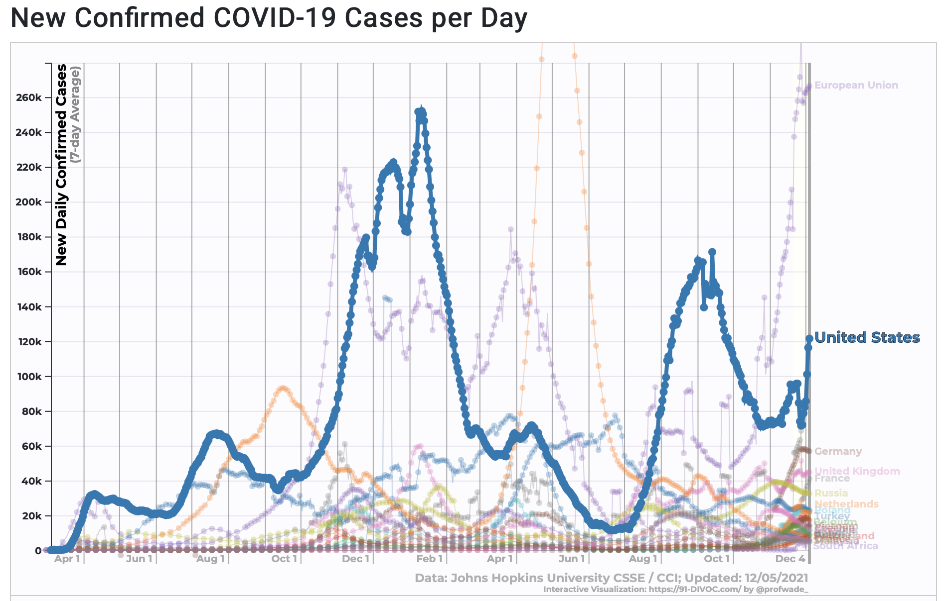
Cumulative Cases
Global: 265,847,554
US: 49,085,361
California: 5,109,348
San Diego Cty: 385,396
Cumulative Deaths
Global: 5,255,544
US: 788,363
California: 74,802
San Diego: 4,346
Johns Hopkins CSSE 11.30.2021

Slide 8
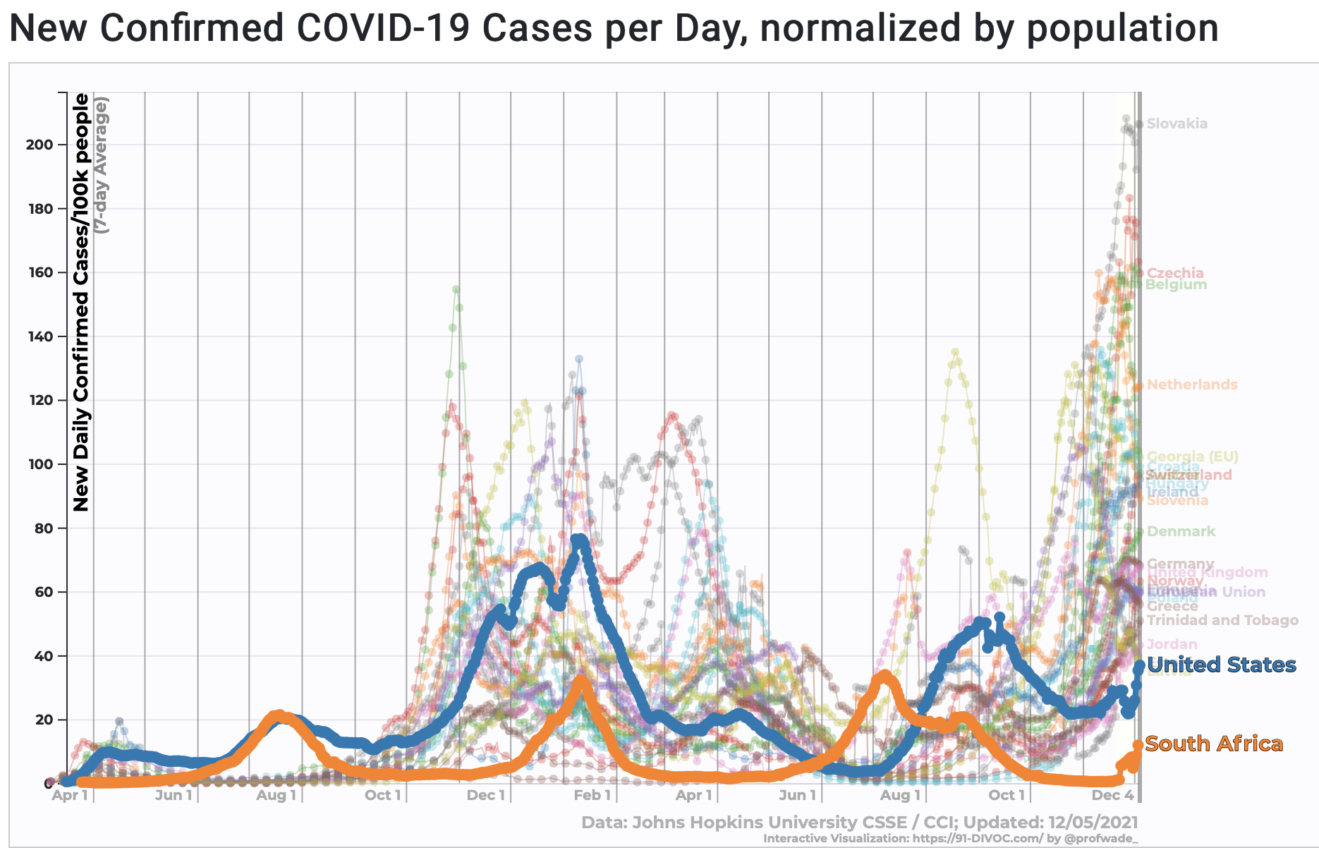
Cumulative Cases
Global: 265,847,554
US: 49,085,361
California: 5,109,348
San Diego Cty: 385,396
Cumulative Deaths
Global: 5,255,544
US: 788,363
California: 74,802
San Diego: 4,346
Johns Hopkins CSSE 11.30.2021

Slide 9
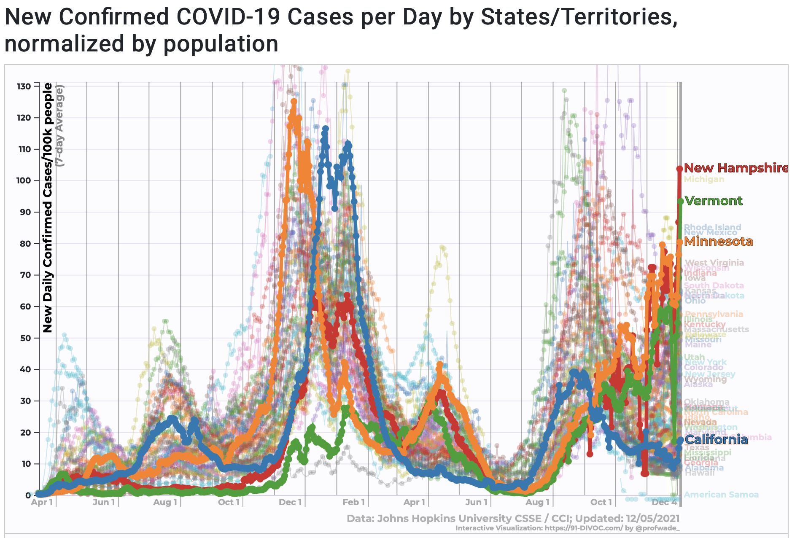

Slide 10
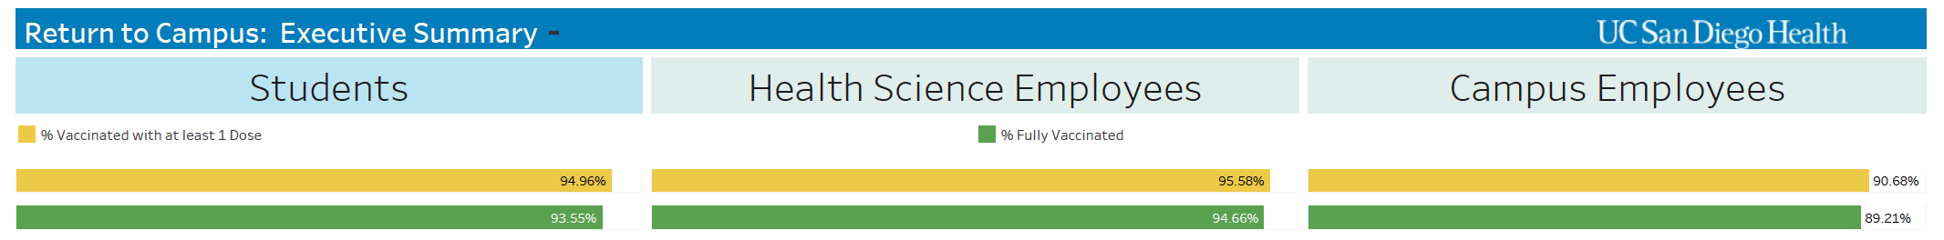
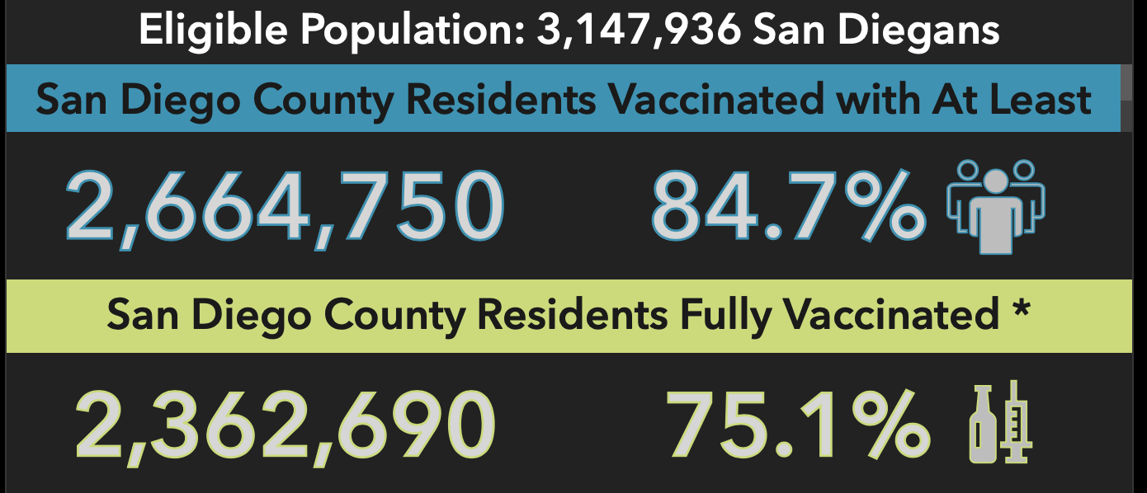
Vaccination Update
96.6
96.0
92.6
96.0
95.6
91.6

Slide 11
Omicron

Slide 12
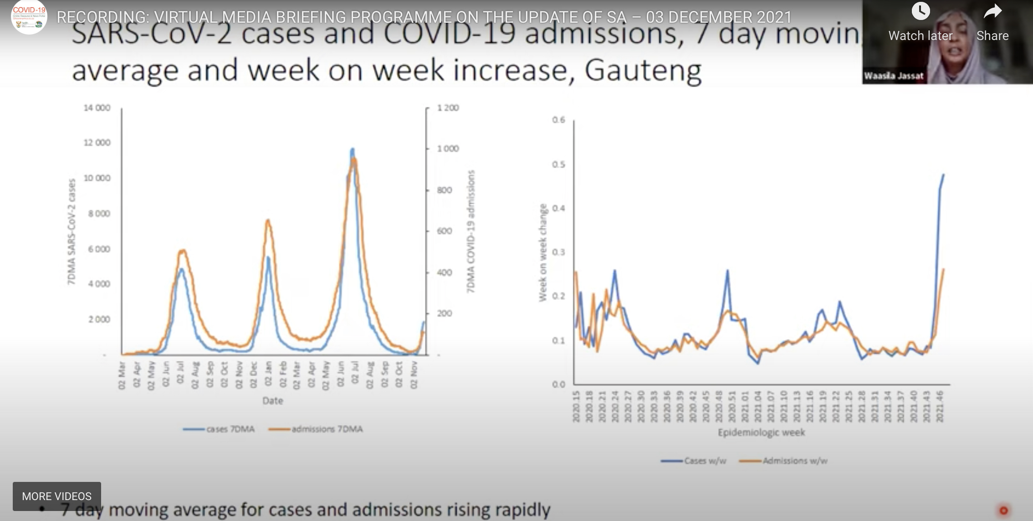
https://sacoronavirus.co.za/2021/12/03/recording-virtual-media-briefing-programme-on-the-update-of-sa-03-december-2021/

Slide 13
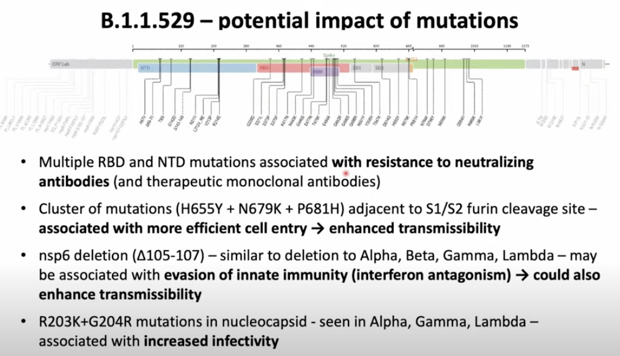

Slide 14
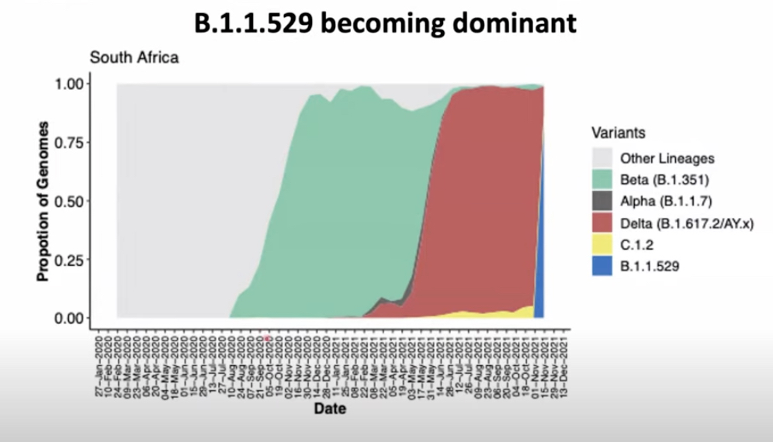

Slide 15
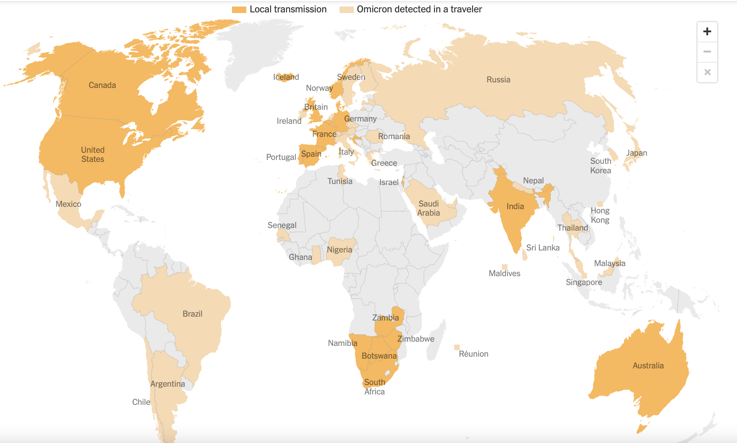
Countries with confirmed Omicron (54 as of 12/6)

Slide 16
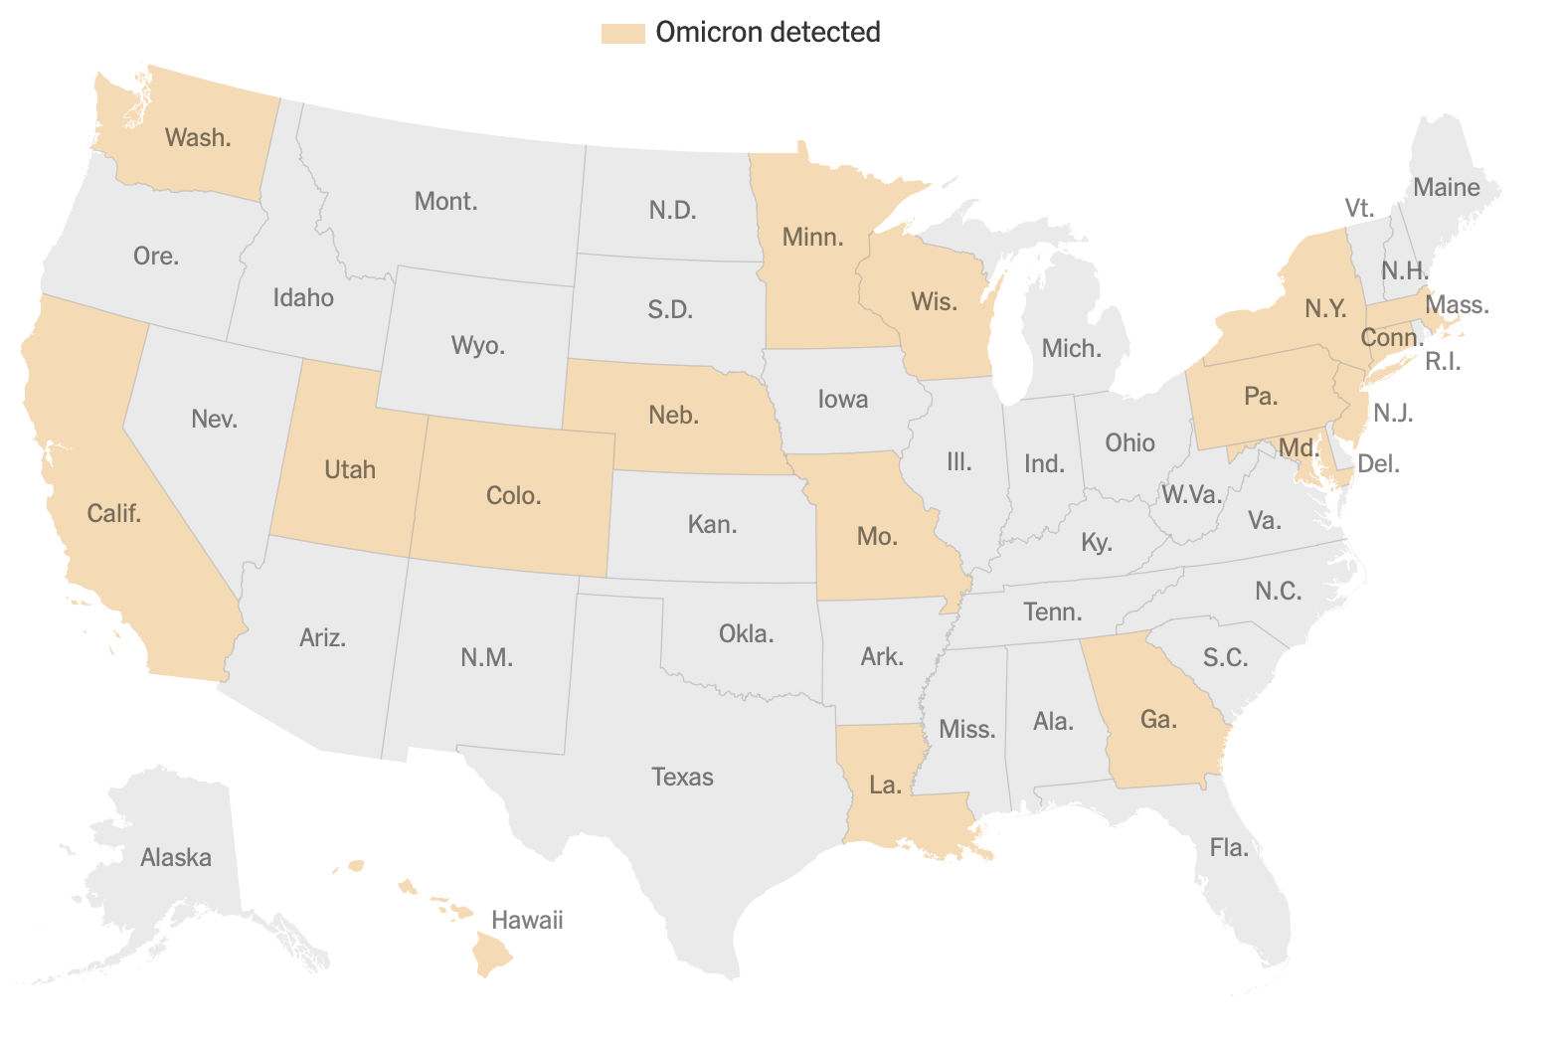
States with confirmed Omicron (17 as of 12/6)

Slide 17
Omicron: Current Status
Novel SARS CoV-2 variant first detected in South Africa ~2 weeks ago
Multiple mutations
  Spike Protein: resistance to neutralization
  Nsp6: evasion of the innate immune response
Rapidly becoming dominant strain in South Africa
  Detected in 54 countries and 17 U.S. states by 12/6/2021
Likely to be less well neutralized by antibodies from infection with prior strains, current vaccines and monoclonal antibodies
Disease Severity
  vaccinated population (especially the boosted population) seems to be much like breakthrough infection with Delta strains
  More severe in elderly and immunocompromised
  Potentially a major problem for the unvaccinated because of greater infectivity and more rapid viral kinetics

Slide 18
Status & Recommendations for UC San Diego
We are well situated to meet the omicron challenge
  Highly vaccinated students, faculty and staff
  Robust sequencing program
    Individual testing
    Wastewater testing
  Highly engaged student body
Get vaccinated (if unvaccinated) or boosted (if vaccinated)
No current change in campus mitigation plans but remain poised to modify our approaches as circumstances evolve

Slide 19
MASKING and TESTING UPDATE
Masking
All indoor spaces - regardless of vaccination
  Individuals may briefly remove masks for eating or drinking
  Alone in enclosed personal office masking not required
Outdoors
  Encouraged crowded situations – consider N95, KN 95
  Exposed vaccinated employees, students must mask at all times
  Testing
Regardless of vaccination status – ALL!!!
  Symptoms
  Wastewater – residential students required/ others strongly encouraged
  Exposure – upon notification and day 5
Surveillance Testing in Winter Quarter:
  Returning Residential student – arrival & day 5
  Encouraged for others
  Surveillance – TBD

Slide 20
BOOSTERS!!!
Eligiblity
  18 years and older
    6 months after Moderna and Pfizer (mRNA vaccines)
    2 months after J&J (adenovirus)
    If WHO approved killed virus - now
    Immunocompromised – speak with provider
Mandate
  Currently not required – could change
Access
  Mix or Match
  RTL site – HS locations and Price
  Appointments required
Chancellor’s challenge
  10,000 students boosted by 12/31/2021 - $50,000 donation to Basic Needs

Slide 21
EXPOSURE UPDATE – QUARANTINE GUIDELINES
Case Investigation & Contact Tracing – UC San Diego Public Health and SHS
Exposed unvaccinated
  Remain off campus
    Residential Students moved to quarantine housing
  Test upon notification and day 5 post exposure
  Monitor symptoms, daily screener 7 days; Return for employment after 10 days
Vaccinated
  May be on campus
    Masking in outdoor spaces required
    Eat alone
    Residential students with a roommate moved to quarantine housing
  Test upon notification and day 5 post exposure
  Monitor symptoms, daily screener for 7 days

Slide 22
Important Changes to NIH Applications: Effective Jan. 25, 2022
Biosketch and Other Support: Include all resources (monetary and in kind) in support of and/or related to all research endeavors. *Changes to the actual form.
Other Support: Include all active and pending monetary and in-kind resources, domestic and foreign, in support of or related to investigator’s research endeavors. *Signature and electronic certification from Principal Investigator and all Senior/Key Personnel required.
Supporting Documentation: If Other Support includes foreign activities and resources, an English version of the contract, grant or any other agreement with the foreign entity must be provided during JIT, following Other Support.
Notification of Undisclosed Other Support: Required to immediately report to the agency when it discovers that a PI or Senior/Key personnel did not disclose Other Support information during submission of JIT or RPPR or when new support is identified.

Slide 23
Enterprise System Update -- VCFO Pierre Ouillet
Listening sessions
Progress on issues
Improved support model
Improved staffing

Slide 24
Main issues list summary
12 high, 28 medium priority issues (10 pending prioritization by committee)
Advisory Committee “Main Issues List” now published, with weekly sub-group meetings (Tuesday from 2-4p) to review new and existing issues, planned solutions, timeline, and verify completion.
Standing Agenda: (1) Review Progress, (2) Prioritize new issues, and (3) Discuss planned resolution by priority
Metrics as of 11/30
50 reviewed issues
14 completed and ready for verification
4 verified by sub-group as completed
https://financialmanagement.ucsd.edu

Slide 25
Top issues
Rebuild the Faculty & Researcher Panorama in Cognos leveraging the Financial Activity Hub to improve speed and performance
Incorporate personnel expense (incl. payroll) projections per project/task
Target start of testing in January
Reduce Fund Manager workload and improve financial report accuracy by adding data entry validation using WalkMe
UC Path in acceptance testing and Procurement module enabled
Roll out of browser plugin started October 28
Reduce Fund Manager workload by synchronizing the UC Path Labor Ledger with Oracle and eliminating the need for reconciliation
Working with UC Path Center to identify short- and long-term solutions
Non-Salary Cost Transfer deficiencies adding to Fund Manager workload
Request to improve non-salary cost transfer screens submitted and actively being worked on by UCSD/Oracle, delivery TBD
Enhancement requests to be reviewed by Committee Subgroup to ensure adequate coverage

Slide 26
Improved support model
VC Area support
Tiger/SWAT teams
Central Finance Help Desk
One-stop shop for all things Finance
Proactive reconciliation and outreach
Process and System Support
Process and policy Subject Matter Experts (SME)
Functional and Technical Configuration (SME/ITS)
Vendor issue management (ITS)
Live phone support during business hours
Local communities of practice
System integration (ITS)
Department Users
Triage issue as appropriate
Finance Help Desk
Begins on December 15
Reconciliation team backend begins in January
Connects with existing IPPS help desk
Live responders from 10:00 – 3:00
Talk/Desk phone technology

Slide 27
Staffing update
Improved career paths, Addressed equity issues, Diversified recruitment
Hired a central pool of career employees to support departments with staffing shortage. So far, 7 fund managers hired into to the pool have gone through a new bootcamp developed by our partners in Research Affairs with 8 more going in December.
Our overall research administrator staffing levels have improved from 274 on July 1 to 305 on Dec 1. Staffing from our career pool will augment these numbers by 15.
Still 58 open positions in HireOnline in various stages of the recruitment process

Slide 28
Research News – SAVC Miroslav Krstic
On-site activity at full capacity
Those working on-site (or at offsite UCSD facilities) must comply with all campus policies:
vaccination (https://returntolearn.ucsd.edu/vaccine-mandate/compliance/index.html),
completion of Work Location Status Tool
daily symptom/exposure screen,
in-person meetings and events (https://returntolearn.ucsd.edu/resources/event-planning/index.html), and
use of face masks when indoors
Notes:
In light of new variant, compliance with campus policies more important than ever.
Vaccination mandate compliance: note that all staff hired after October 16th have two weeks to comply with mandate. Documentation of vaccination must be completed through MyChart (not through provision of proof of vaccine to one’s supervisor).
Work Location Status Tool must be completed by each employee.
COVID-19 Symptom/Exposure Screen should be completed each day BEFORE an employee comes to campus; it should also be completed when a local employee is working off-campus.

Slide 29
International Travel: International Students and Programs Office is monitoring guidance and requirements for entry into the US; Current restrictions; will work to keep all informed.
Updated policies are available at https://ispo.ucsd.edu/news/immigration-policy.html
Sponsored Project Offices:
Launched Faculty Advisory Committee a new source of input and feedback from researchers; contact Ross Dammann (rtdammann@ucsd.edu) with Qs/suggestions
2-week closure of SPOs (Proposals due December 22– January 3):
The proposal package with draft science must be routed to OCGA through Kuali Research no later than 8:00 am, Wednesday, December 15, 2021.
Beginning in January, submission of proposals guaranteed only to submissions meeting 14/5/2 deadlines.
Notes:
International Travel:
Noncitizens who were physically present in certain South African countries (Republic of Botswana, the Kingdom of Eswatini, the Kingdom of Lesotho, the Republic of Malawi, the Republic of Mozambique, the Republic of Namibia, the Republic of South Africa, and the Republic of Zimbabwe) within 14 days of entry are not permitted to enter the US.
All those entering the US must have a negative COVID test within 24 hours prior to departure from originating location.

Slide 30
New Resources/opportunities in Research Development
Internal grant writing support for large proposals
NSF STC and ARPA-H proposals fully supported by RD team
Research Ethics Program: will be launching a new Faculty Advisory Committee to help with program development
Notes:
Research Development:
We’re adding a Life Sciences Associate Director to expand our expertise and bandwidth
Additional staff additions will also expand our bandwidth
The new freelance Grant Writing program is up and running.
Research Ethics:
In 2022, will have a new Faculty Advisory Committee to help guide Research Ethics program

Slide 31
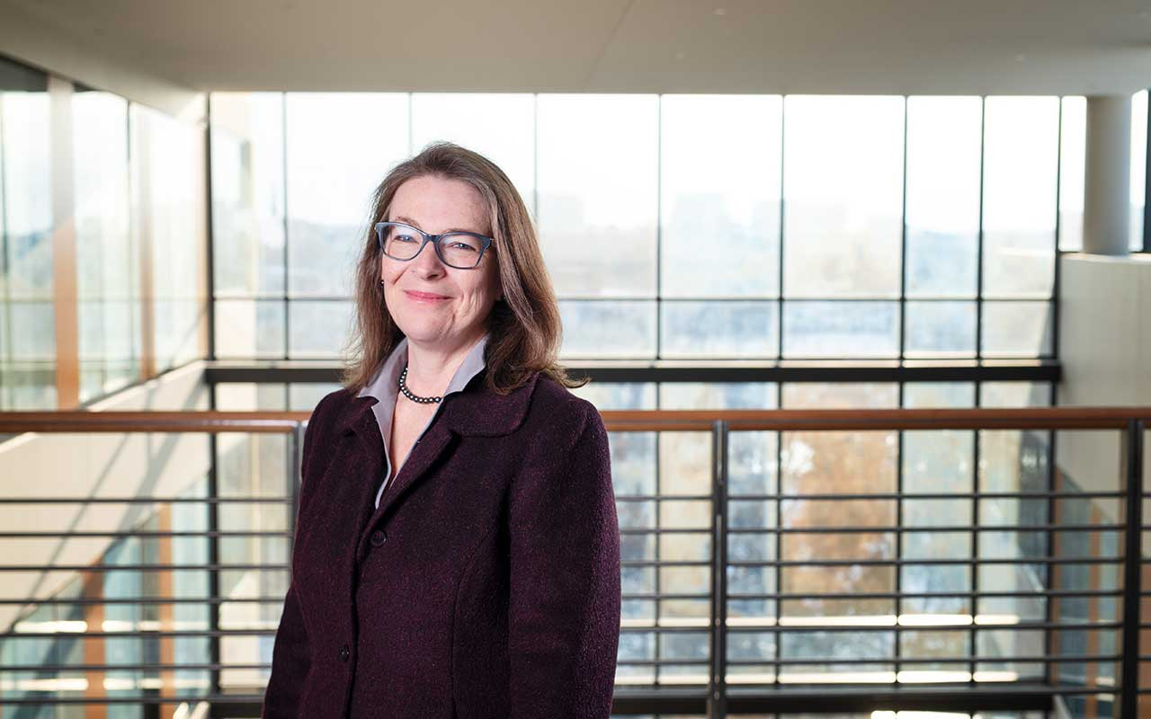
Welcome, incoming VC Research Corinne Peek-Asa!
University of Iowa
Lowell G. Battershell Distinguished Professor
Associate Dean for Research, College of Public Health
Notes:
From the press release:
A pioneer in the field of international injury and violence epidemiology,
Currently directs one of six NIH-funded International Trauma Training Programs
Prior director of the interdisciplinary CDC-funded Injury Prevention Research Center from 2006 to 2020.
Peek-Asa has served on the Board of Scientific Counselors for the National Institute for Occupational Safety and Health,
currently an appointed committee member of the National Academies’ Transportation Research Board.
serves on the National Academies of Sciences, Engineering and Medicine’s Committee on Accelerating Progress in Traumatic Brain Injury Research and Care,
elected to the National Academy of Medicine in 2020.

Slide 32
Q&A
Please use Q&A button on the bottom of your webinar screen
On the call to answer questions today:
VC Research: Sandra A. Brown
Continuity of Research Task Force Chairs: SAVC Miroslav Krstic and Dean Jim McKerrow
Pandemic Trends: Dr. Natasha Martin, Dr. Angela Scioscia
ESR: VCFO Pierre Ouillet, Kevin Chou, Cheryl Ross
Contracts and Grants: Ross Dammann
Incoming VC Research: Corinne Peek-Asa
EH&S: Lance Scott
Human Resources: Terri Winbush
International Students and Scholars: Roark Miller
IRB/Human Subjects Research: Benjamin Mooso
Postdoctoral & Research Scholar Affairs: Jennifer Bourque
Research Development: Wendy Groves, Lynsey Fitzpatrick

